Slide 1
A Look Inside the World of Lobbying and Politicians
David Rodgers, Austin McClain, Carolyn Chu,
Romario Leal, and Will O’Connor

Slide 2
Research Topics
Lobbying contributions ($) by…
Geographic Distribution
By Political Party
Within State vs Out of State
By Gender
Over Time
(Longitudinal)
Differences Among States
Notes:
We started with brainstorming questions. We had more than this but some of them didn’t make the cut based on what data we were able to find and the time we were given for the project.

Slide 3







Potential Data Sources

Slide 4

Data Sources Used

Slide 5
Data Sources Used
Congress Member Details:
Name, Start, End, Party, Gender
Contributions from 2013-2023
(1.6 million datapoints)
Contained both in CSV

Slide 6
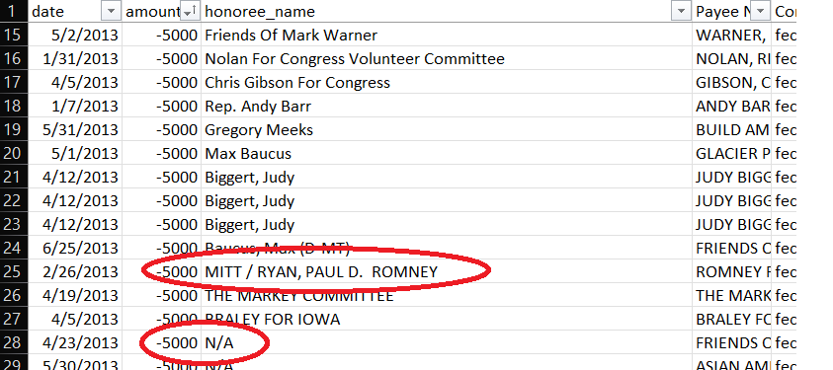
Assumptions and Discrepancies in the Data

Slide 7
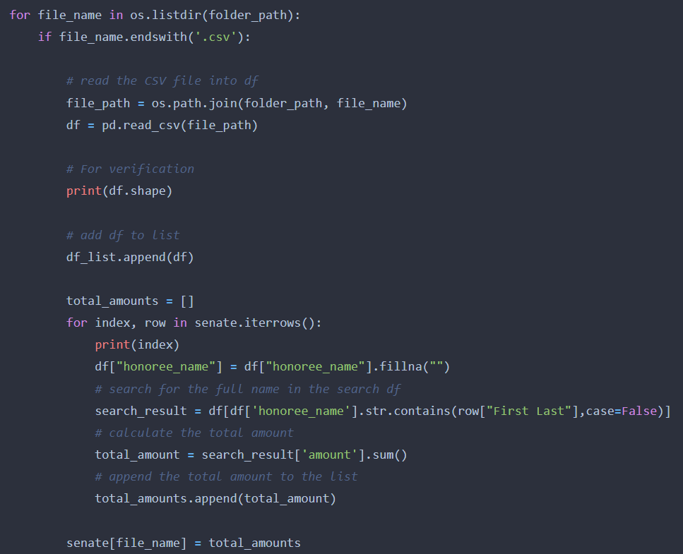

Slide 8
Lots of name formatting

Slide 9
What portion of a senator’s lobbying contributions come from out of state vs within state.
Presenter: David

Slide 10
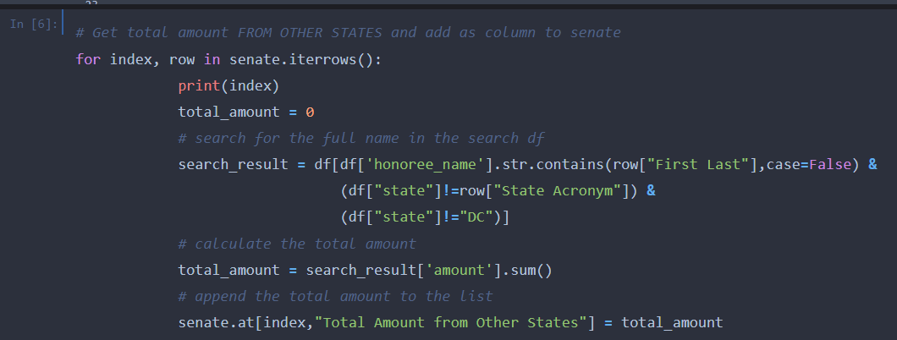
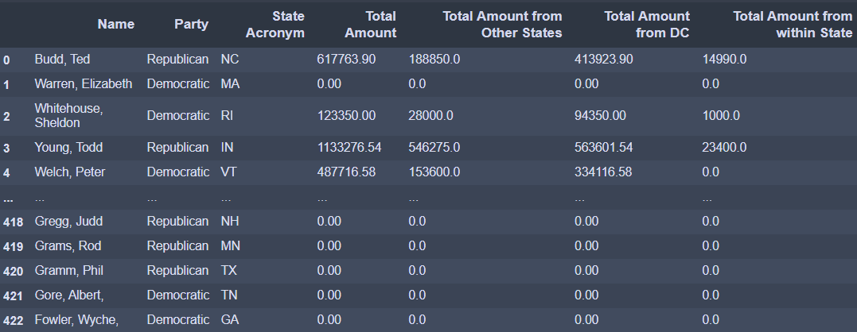
In State vs Out of State Contributions for 2022

Slide 11
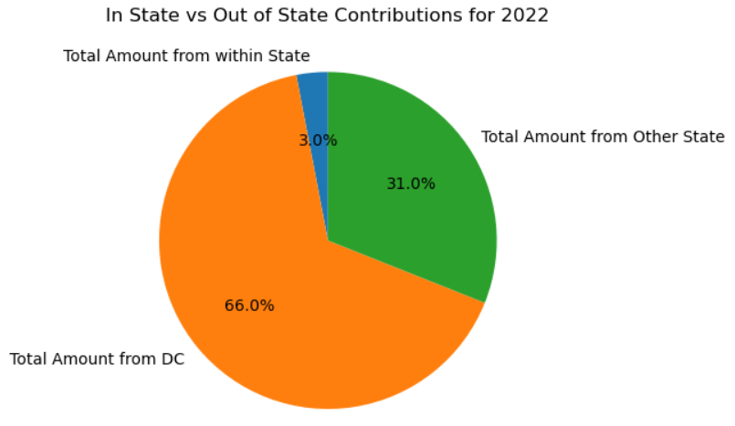

Slide 12
What is the geographic distribution of contributions?

Slide 13
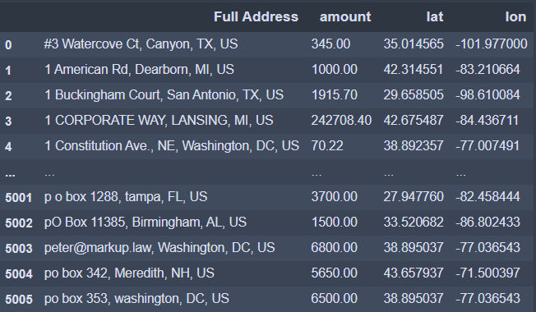
Data for Geographic Distribution
Notes:
Used a group by and then geocode to get lat lon

Slide 14
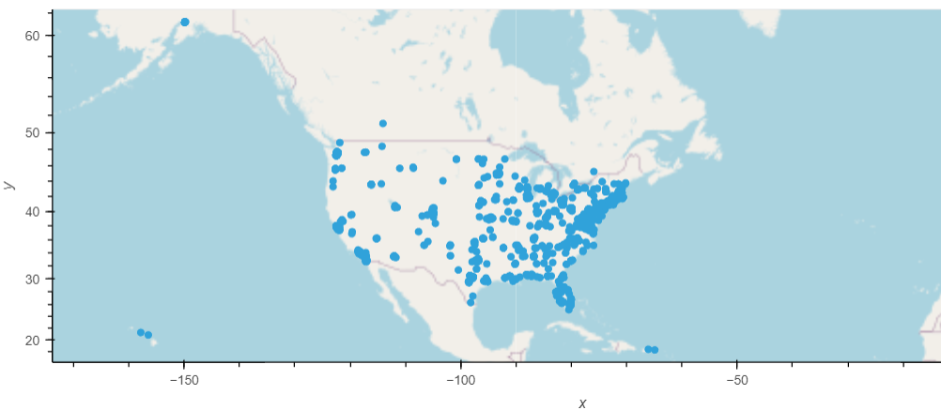
2022 Geographic Contributions

Slide 15
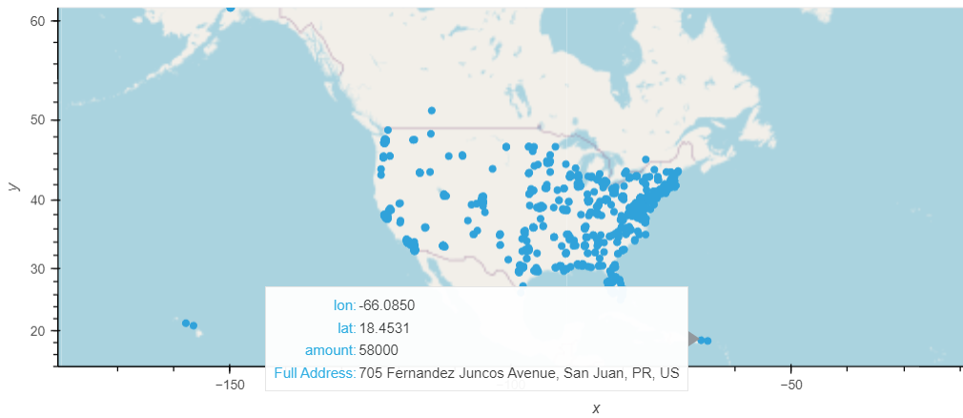
2022 Geographic Contributions - Puerto Rico focus

Slide 16
Which political party gets more lobbying money for a specific time frame? And what is the impact on elections?
Presenter: Austin

Slide 17
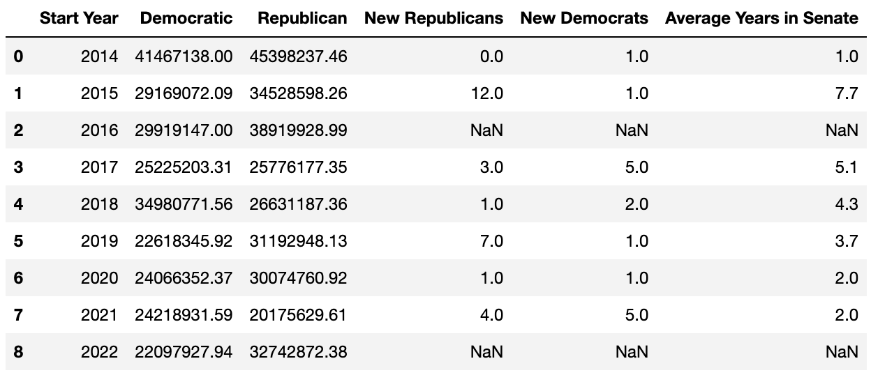
Summary Table

Slide 18
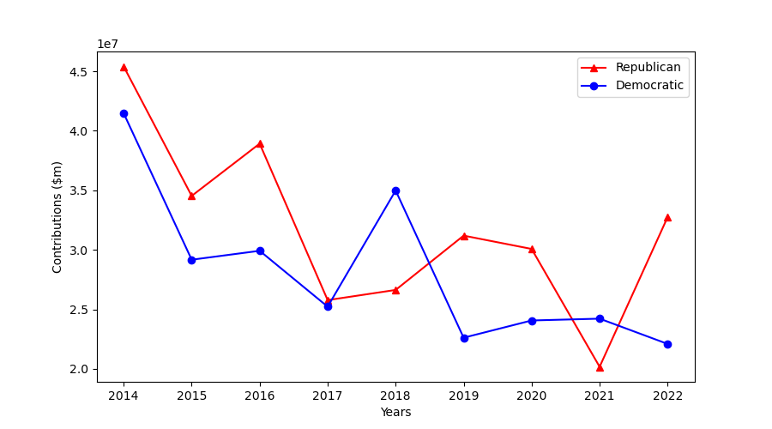
Trend in Contributions to Senators

Slide 19
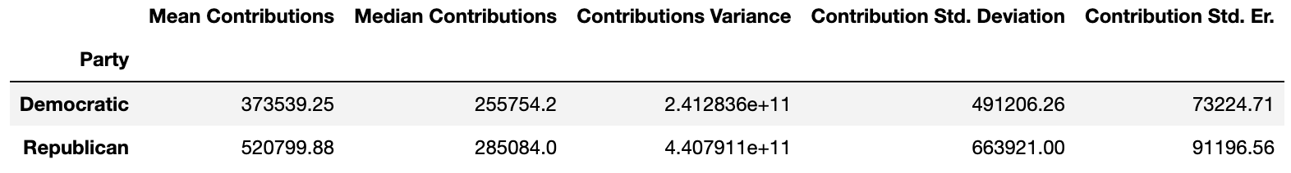
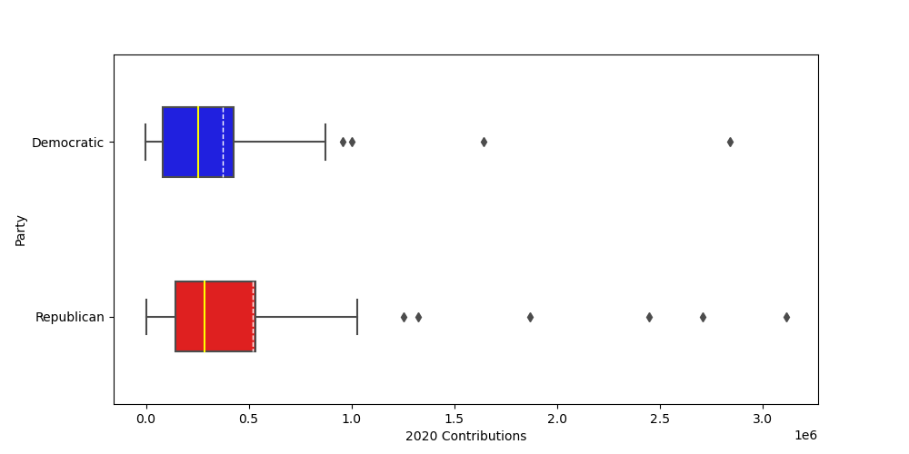
Looking closer at 2020

Slide 20
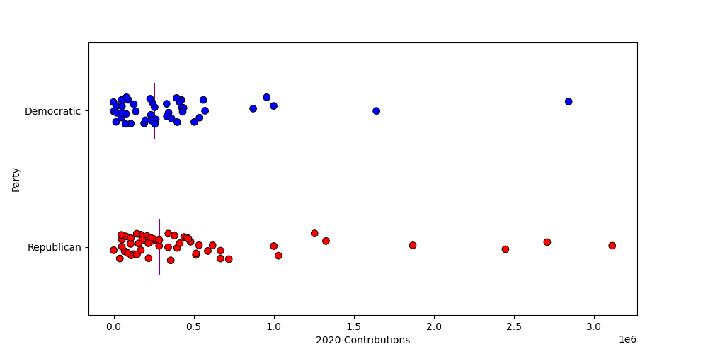
Another Look at 2020: A Splitplot

Slide 21
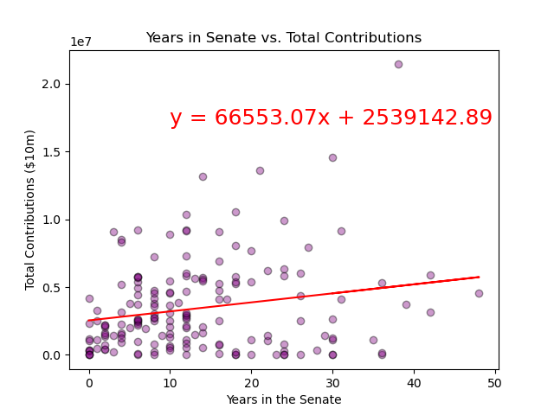
r= 0.20, p = 0.007

Slide 22
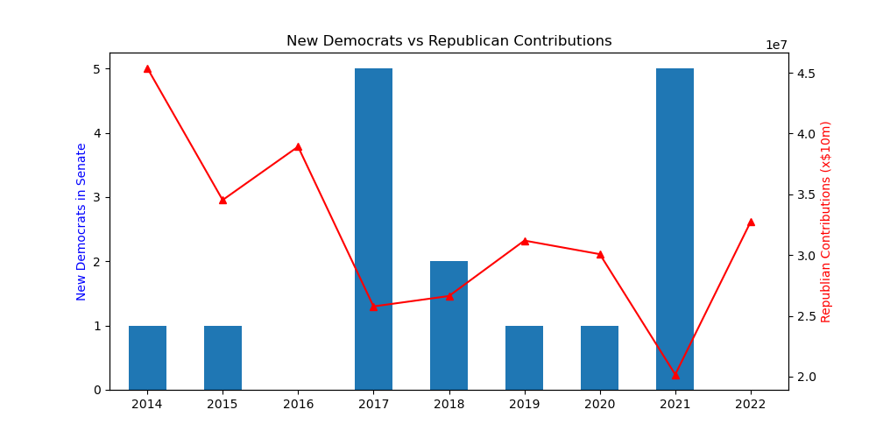

Slide 23
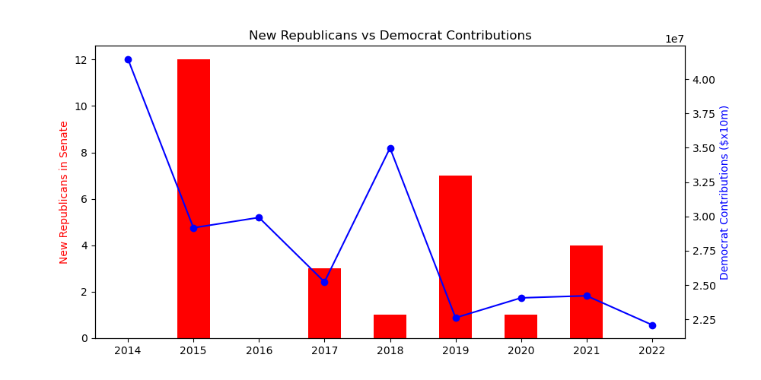

Slide 24
Presenter: Carolyn Chu
Does gender have an effect on the average total contribution received?

Slide 25
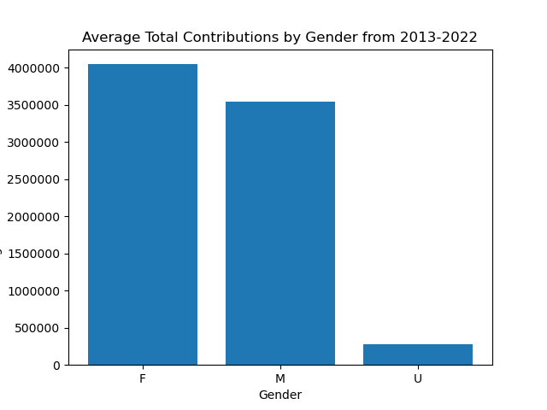
Notes:
This graph shows the average total contributions by gender from 2013-2022. This includes a column for “undefined” genders. A limitation of the data set is that the genders were based on the senator’s honorific title, such as MR and MRS. Senators that did not select a gender based honorific title, were included in the undefined column. Females had the highest average total contribution during this time period.

Slide 26
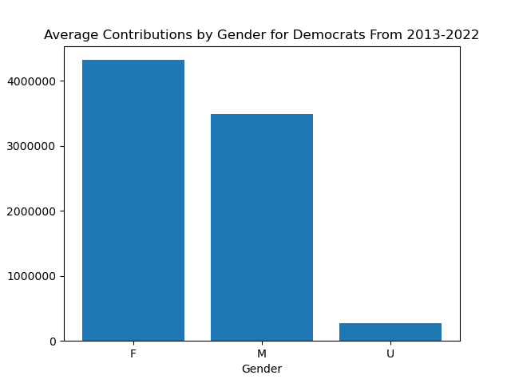
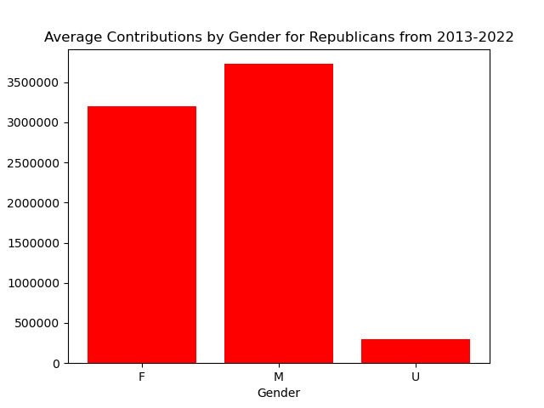
Notes:
We took it a step further to see if the political party of a senator made an impact on the results of our previous chart. As you can see on the graph for the democratic party, females had a higher average contribution compared to their male counterparts. The opposite can be said for the republican party with males having a higher average contribution compared to females. We understand that there are different proportions of females to males in each political party during this time period. Instead of using total contributions, we took the average contribution by gender to normalize the data.

Slide 27
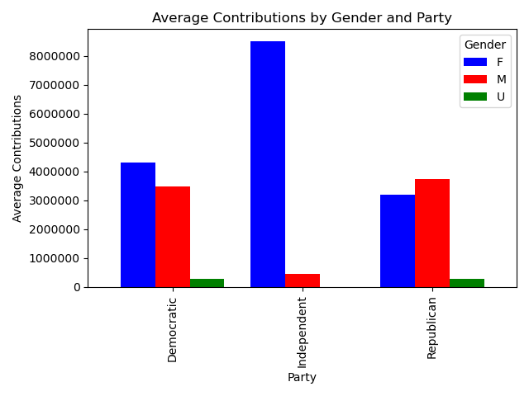
Notes:
When including the “independent” party to the dataset, we can see that the contributions are skewed heavily to the female senators in that political party.

Slide 28
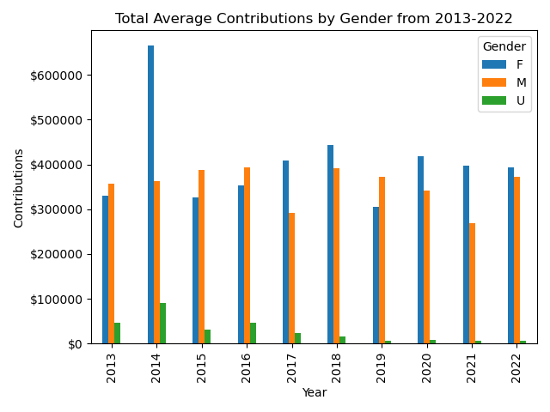
Notes:
Now looking at the data by year, there is not a clear trend for either gender. In 2014, the average contributions between females and males were disproportionately skewed toward female senators. There are several confounding factors influencing contributions that our dataset is not able to account for.

Slide 29
Presenter: Romario Leal
Does the average number of contributions made to a political party for elections vary significantly across states?

Slide 30
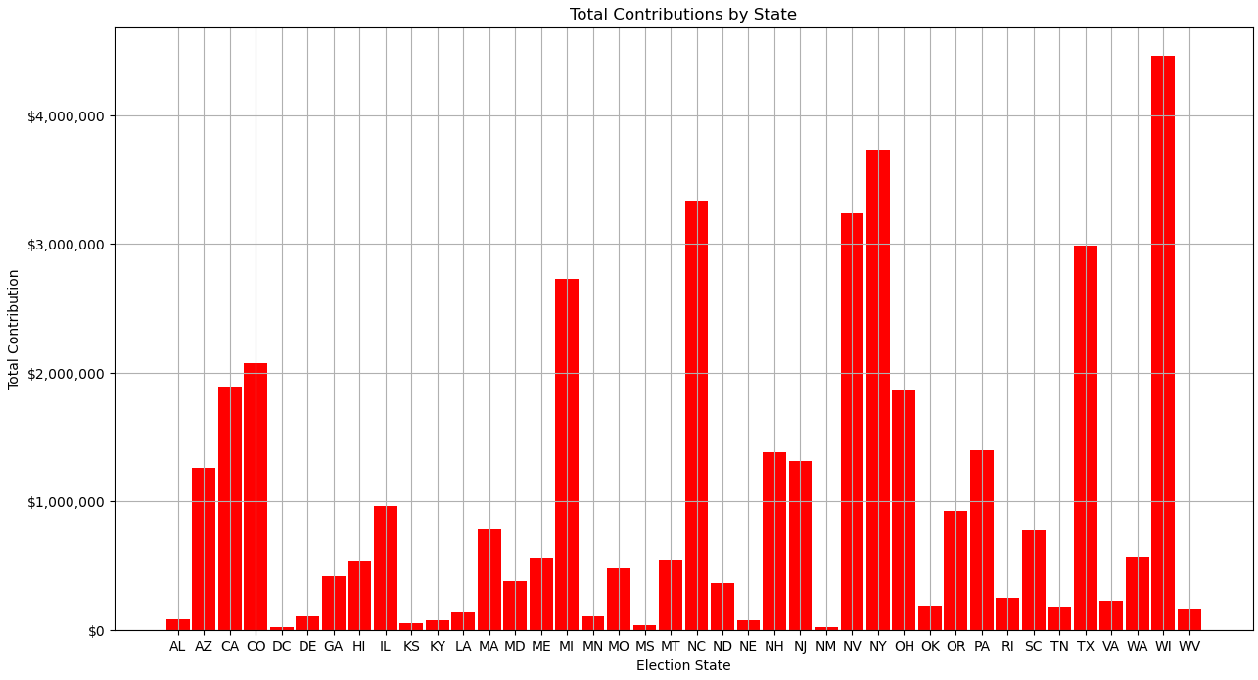

Slide 31
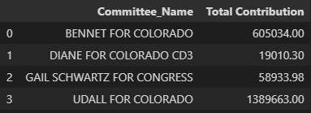
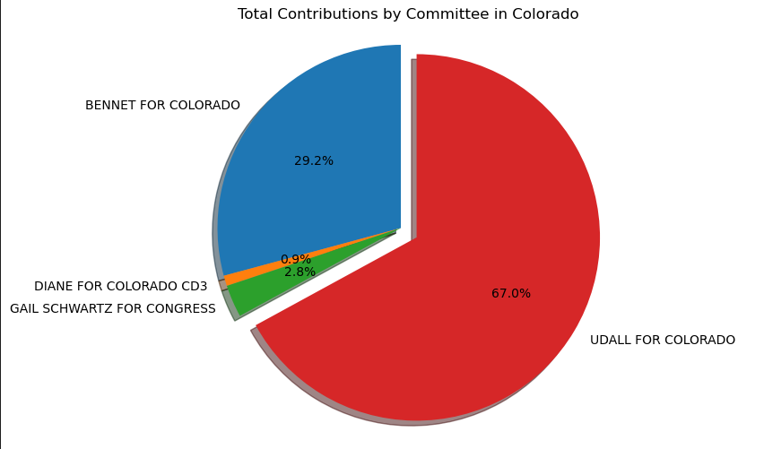
Focused Study: Colorado

Slide 32
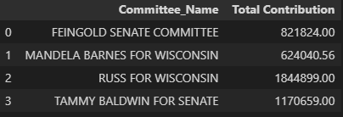
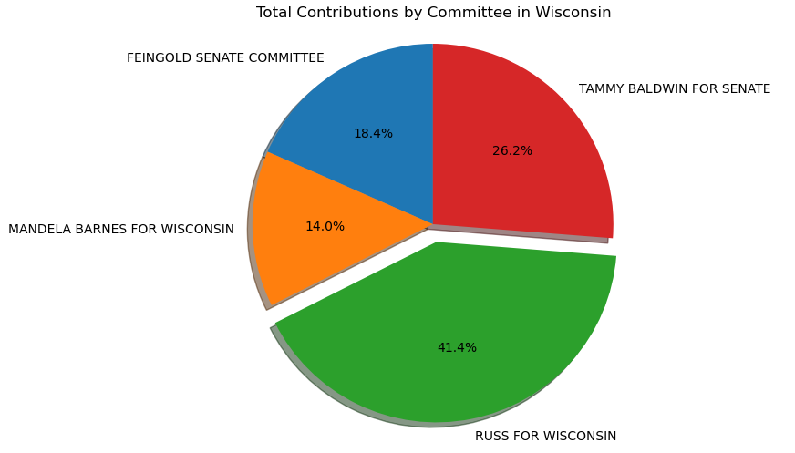
Focused Study: Wisconsin

